Slide 1
Introductory Data Science and Machine Learning
CP1407
Lecture #1
Introduction to Data Science

Slide 2
What this subject is about?
Subject Learning Outcomes
Describe what data science is and the skill sets needed to be a data scientist
Describe the data science process and how its components interact
Explain in basic terms what Machine Learning means and the significance of Machine Learning in data science
Identify differences in various machine learning algorithms, principles and application purposes of each algorithm
Apply basic tools to carry out data analysis using exemplar machine learning algorithms

Slide 3
Lecture Overview
What is Data Science?
Two aspects of data science
Skill set required for data science
Machine Learning
What this subject is about

Slide 4
Pre-Reading List
Pre-Lecture work (reading) for students:
“Defining Data Science” (2015), written by Yangyong Zhu and Yun Xiong (https://arxiv.org/ftp/arxiv/papers/1501/1501.05039.pdf)
https://www.quora.com/What-is-data-science
https://www.safaribooksonline.com/library/view/doing-data-science/9781449363871/ch01.html
Textbook (Data Mining: Practical Machine Learning Tools and Applications) – Chapter 1

Slide 5
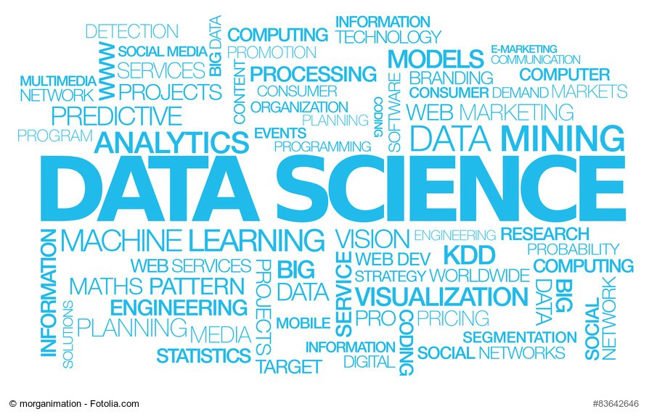

Slide 6
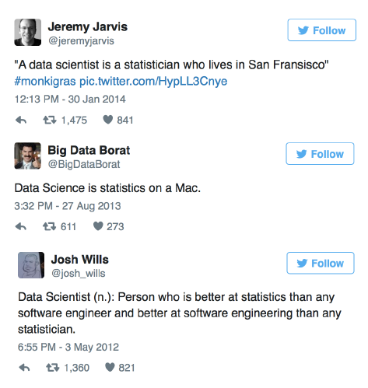
Data Science or Statistics?

Slide 7
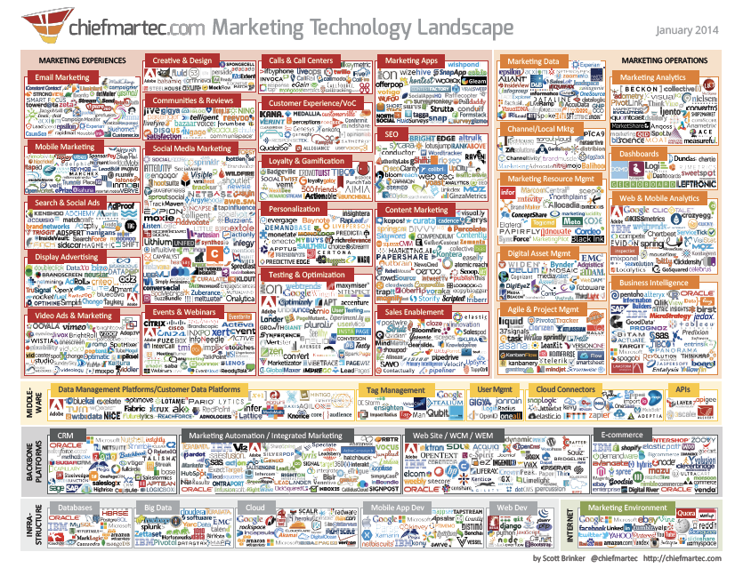
An application in marketing

Slide 8
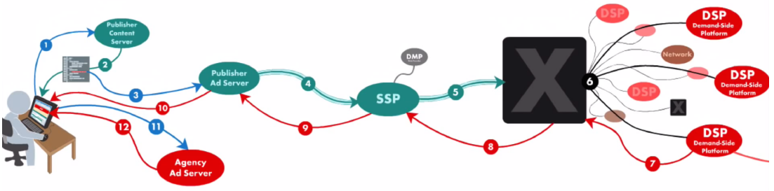
Real time bidding
A customer visits a webpage with his browser : a complex process of content selection and delivery begins.
An advertiser might want to display an ad on the webpage where the user is going. The webpage belongs to a publisher.
The publisher sells ad space to advertisers who want to reach customers.

Slide 9
Machine Learning
Advertisers have 10ms (!) to give a price: they might need to assess quickly how willing they are to display the ad to this customer.
Machine learning is used to predict the probability of click on the ad.
Some figures :
10 million prediction of click probability per second
Answer within 10ms
Stores 20Terabytes of data daily

Slide 10

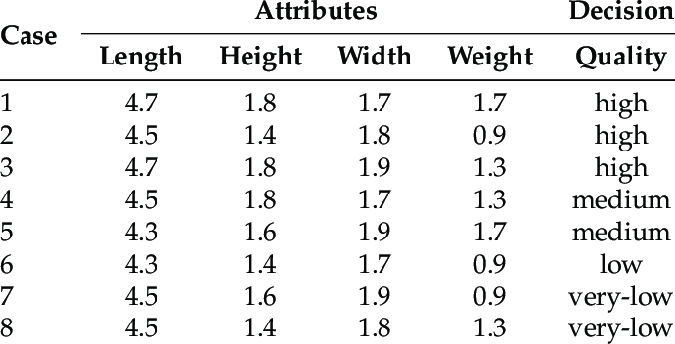
What is Data Science?
Data science, is a process of to extracting knowledge or insights from data in various forms, either structured or unstructured.
Structured
Unstructured

Slide 11
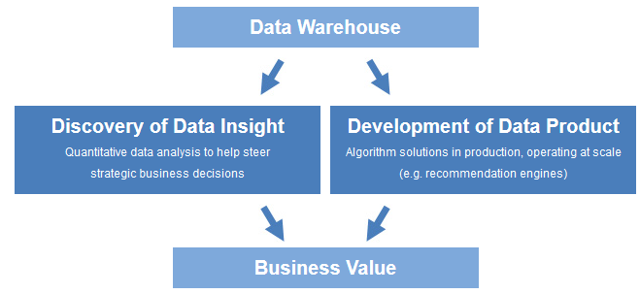
Aspects of Data Science
Discovery of Data Insight
Development of Data Product

Slide 12
From Data to Information: Example
Age
Spectacle prescription
Astigmatism
Tear production rate
Recommended lenses
Data
Young
Myope
No
Reduced
None
Young
Hypermetrope
No
Normal
Soft
Pre-presbyopic
Hypermetrope
No
Reduced
None
Presbyopic
Myope
Yes
Normal
Hard
ML Techniques
…
…
…
…
…
‘Structural Descriptions’ example: if-then rules
If tear production rate = reduced then recommendation = none
Otherwise, if age = young and astigmatic = no then recommendation = soft
Information

Slide 13
Discovery of data insight
Surfacing hidden insight that can help enable companies to make smarter business decisions.
Examples:
Netflix data mines movie viewing patterns to understand what drives user interest, and uses that to make decisions on which Netflix original series to produce.
Proctor & Gamble utilizes time series models to more clearly understand future demand, which help plan for production levels more optimally.

Slide 14
Development of data product
A "data product" is a technical asset that utilizes data as input, and processes that data to return algorithmically-generated results.
Examples:
Spotify recommends music to you.
Gmail's spam filter algorithm processes incoming mail and determines if a message is junk or not (behind the scenes).
Machine learning used for self-driving cars : able to recognize traffic lights, other cars on the road, pedestrians, etc.

Slide 15
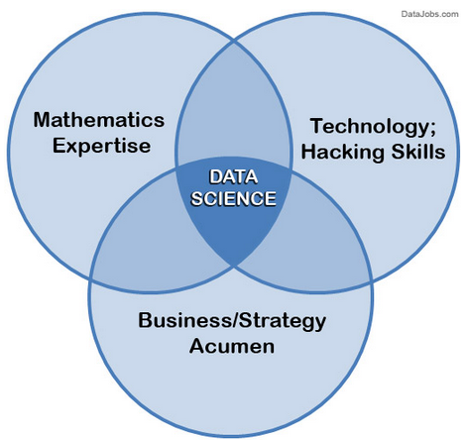
Skill set required for Data Science
Data science is a blend of skills in three major areas:

Slide 16
Mathematics
The ability to view the data through a quantitative lens.
Algorithms require knowledge of linear algebra and Bayesian statistics.

Slide 17
Technology hacking
“Hacking” (not as the term you often see) is about creativity and ingenuity in using technical skills to build things and find clever solutions to problems.
Data scientists utilize technology in order to wrangle enormous data sets and work with complex algorithms which requires sophisticated tools.

Slide 18
Business Acumen
There needs to be clear alignment between data science projects and business goals.
Responsibility to translate observations to shared knowledge, and contribute to strategy on how to solve core business problems.

Slide 19
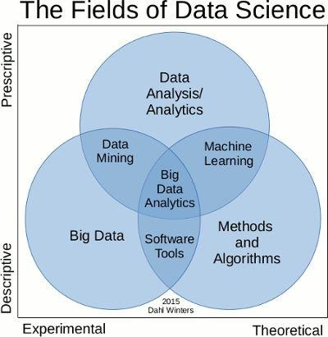
The Fields of Data Science

Slide 20
Analytics vs. Data Science
Analytics is the "science of analysis" — the practice of analyzing information to make decisions.
A data scientist using raw data to build a predictive algorithm. However, an analyst can be a non-technical business user interpreting pre-built dashboard reports.

Slide 21
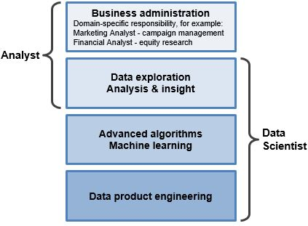
Analytics vs. Data Science
Data Scientist:
Data scientists work at the raw database level to derive insights and build data product.
Analyst:
Analysts may interact with data at both the database level or the summarized report level.

Slide 22
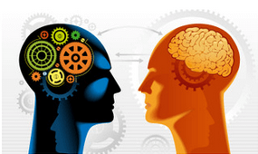
Machine Learning and Data Science
Machine learning refers to a broad class of methods that revolve around data modeling to
Algorithmically make predictions
Algorithmically decipher patterns
Data scientist has to figure out which machine learning technique to use and how to use them in different problems.

Slide 23
Making predictions
Supervised Learning
Using tagged data to train predictive models.
Tagged data: observations where ground truth is already known
Training models: automatically characterizing tagged data in ways to predict tags for unknown data points.
Example: a credit card fraud detection model can be trained using a historical record of tagged fraud purchases. The resultant model estimates the likelihood that any new purchase is fraudulent.

Slide 24
Supervised Learning
Construct a classification model to determine the class of a given record
Model
Construction
Method
Classification
Model
Example Data Set
(a) Model Development Phase
Unseen Data Record with undetermined class
Classification
Model
Data Record with the determined class
(b) Model Use Phase

Slide 25
Pattern discovery
Unsupervised Learning
Discover underlying patterns and associations in data when no existing ground truth is known (i.e. no observations are tagged).
Example: clustering can be used to programmatically learn the natural customer segments in a company's user base.

Slide 26
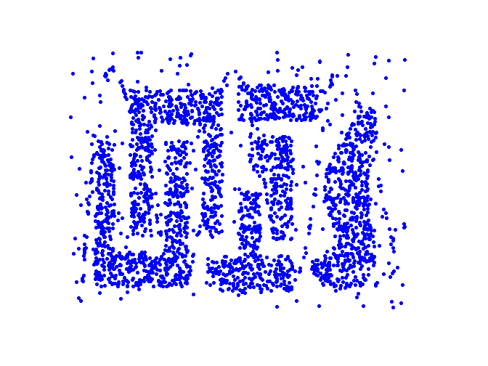
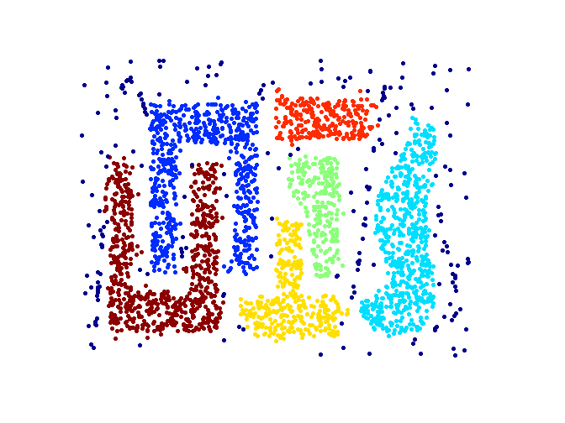
Unsupervised Learning
Measure similarity among data objects and group them into clusters accordingly
Clustering
Method
Input data points
Cluster Memberships of Data Points

Slide 27
Machine Learning vs. Statistics
Statistics
Require statistical properties of the estimator (p-value, mean, variance)
Understand the underlying distribution of the population
Machine learning
Treats an algorithm like a black box, as long it works.
It is generally applied to high dimensional data sets, the more data you have, the more accurate your prediction is.

Slide 28
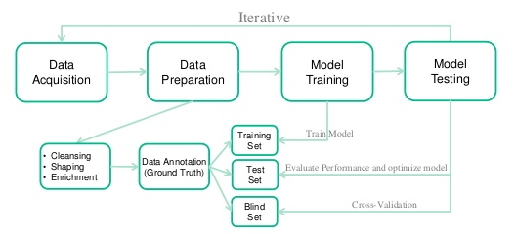
Machine Learning Process
Notes:
More details will be covered in later week lectures

Slide 29
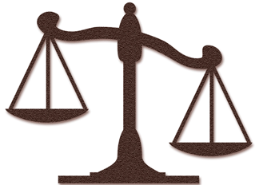
Data Mining and Ethics
Important questions:
Who is permitted access to the data?
For what purpose was the data collected?
What kind of conclusions can be legitimately drawn from it?
Caveats must be attached to results
Purely statistical arguments are never sufficient!
Are resources put to good use?

Slide 30
Summary
Data can be used to make decisions or to create a product
We need to optimise speed, memory and accuracy
You need both coding and maths expertise to analyse data
Machine learning uses algorithms to make predictions
Statistics in contrast uses probability distributions

